Slide 1
PROJECT DESIGN PHASE-1 BRAINSTROM & IDEA PRIORITIZATION
DATE | 20 OCTOBER 2022
TEAM ID | PNT2022TMID50230
PROJECT NAME | COUSTOMER CARE REGISTRY
MAXIMUM MARKS | 4 MARKS

Slide 2
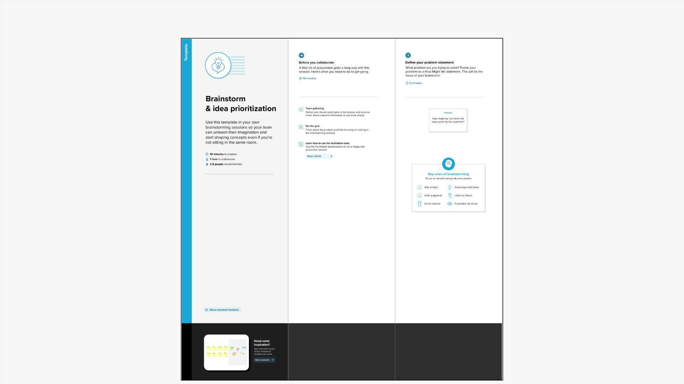
BRAINSTORM & IDEA PRIORITIZATION

Slide 3
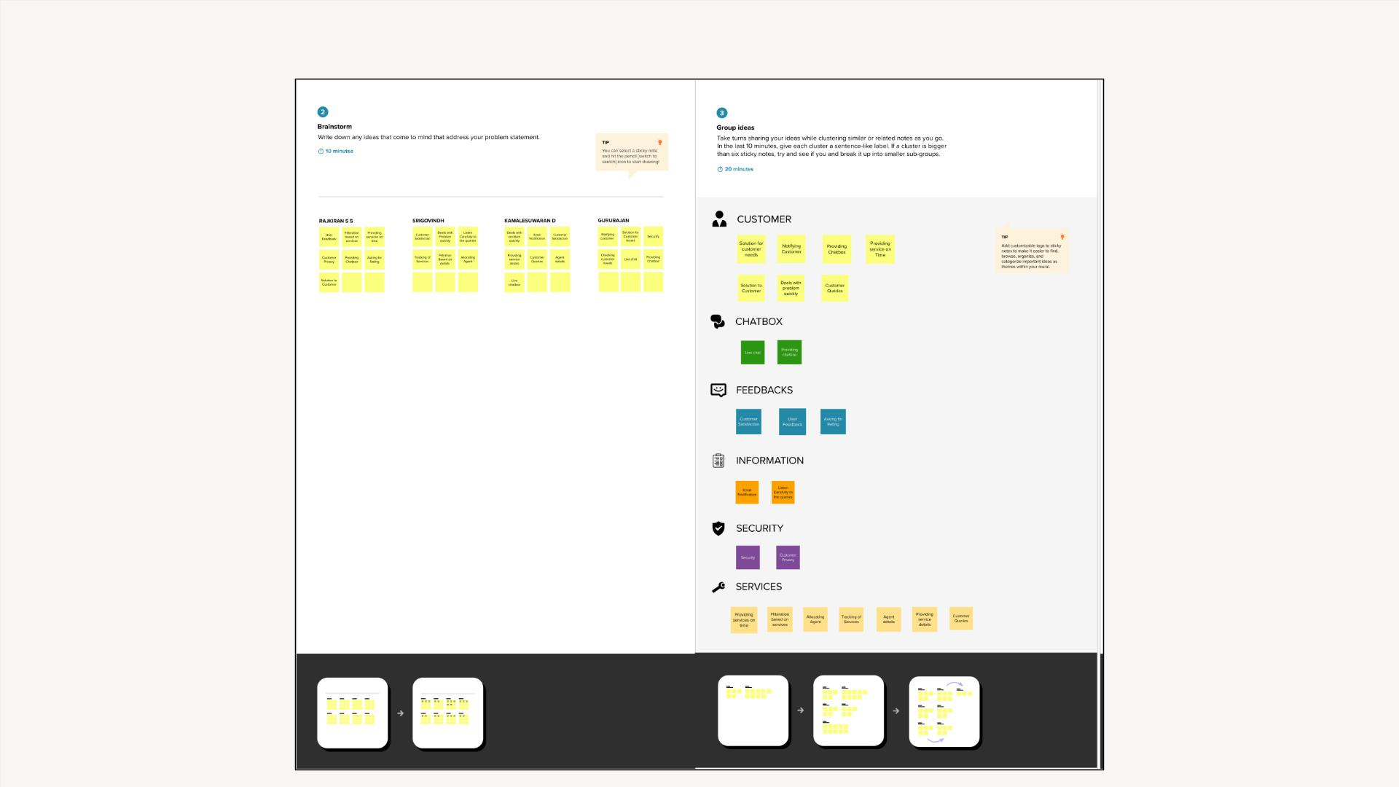
BRAINSTORM & IDEA PRIORITIZATION
5

Slide 4
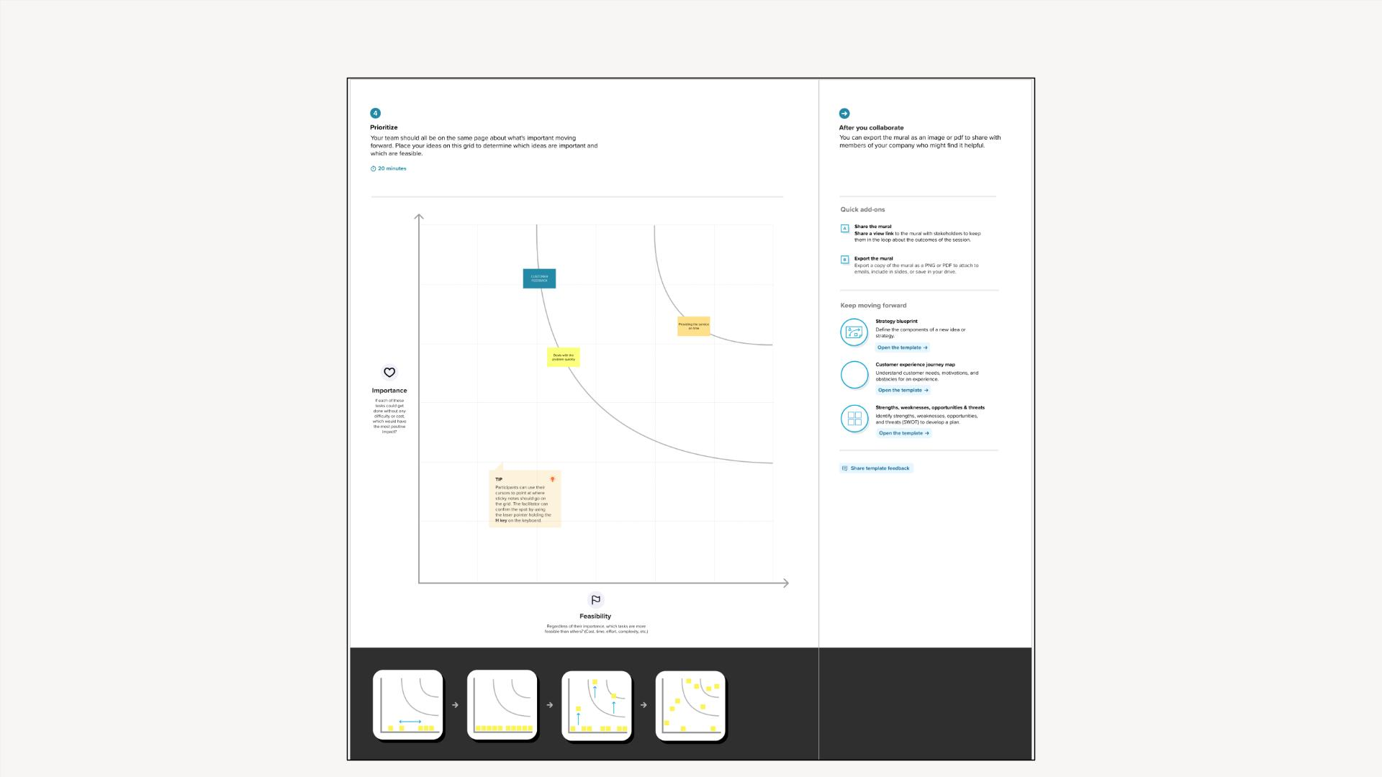
BRAINSTORM & IDEA PRIORITIZATION

Slide 5
